Slide 1
Control Structure Week Tree

Slide 2

What are control structures?
Control structures determine the flow of execution in a program .They control order, decision-making, and repetition
Three main types:
Sequence
Selection
Iteration
This Photo by Unknown Author is licensed under CC BY-SA-NC

Slide 3
Types of control structures
1. Sequence – Executes statements in order 2. Selection – Decision making (branching) 3. Iteration – Repeats a block of code
This Photo by Unknown Author is licensed under CC BY-SA-NC

Slide 4
Sequence Structure
Description:
Default mode of execution
Instructions run one after another
Start → Step 1 → Step 2 → Step 3 → End
Properties:
Simple and linear
No branching or looping
Predictable execution
This Photo by Unknown Author is licensed under CC BY-SA-NC

Slide 5
Selection structure (decision)
if, if-else, switch
Properties:
Enables decision-making
Two-way or multi-way branching
Condition-based execution
This Photo by Unknown Author is licensed under CC BY-SA-NC

Slide 6
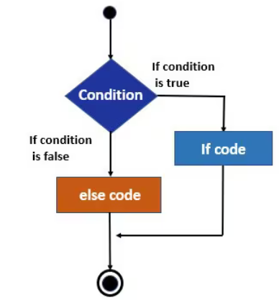

Slide 7
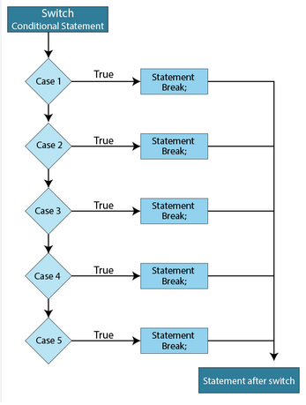

Slide 8
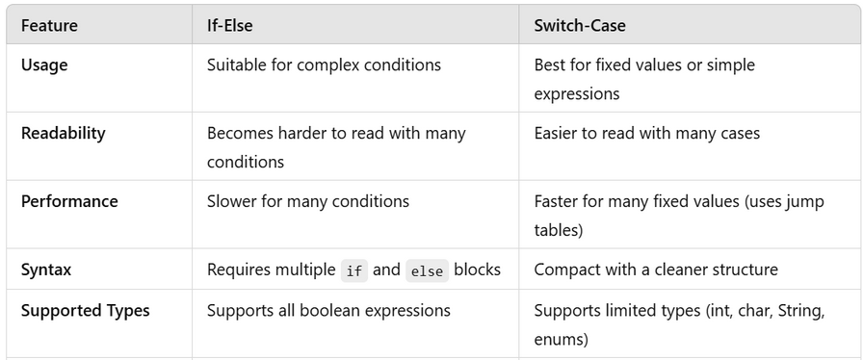

Slide 9
Iteration structure (looping)
Examples: for, while, do-while
Properties:
Repeats code block
Controlled by condition
Risk of infinite loops if not managed
This Photo by Unknown Author is licensed under CC BY-SA-NC

Slide 10
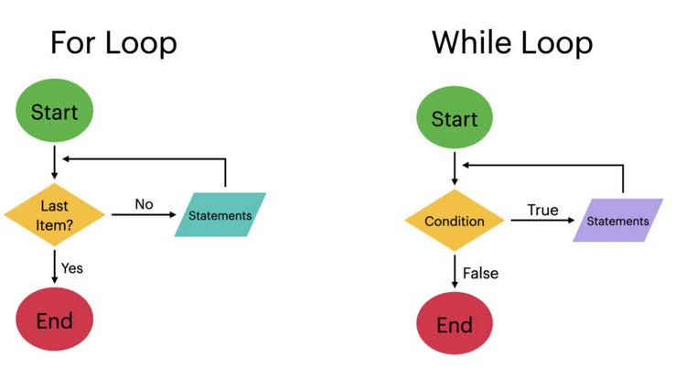

Slide 11
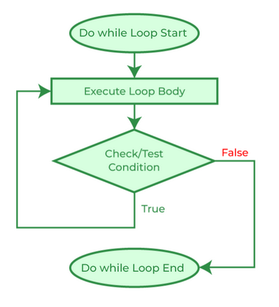

Slide 12
Exception Handling
Programs may encounter unexpected errors during execution
These errors are called exceptions
Exception handling helps manage runtime errors gracefully
Prevents program crashes and improves reliability
This Photo by Unknown Author is licensed under CC BY-SA-NC

Slide 13
Exception Handling
An exception is an abnormal event during program execution
Examples:
Division by zero
File not found
This Photo by Unknown Author is licensed under CC BY-SA-NC

Slide 14
Exception Handling in Java
A mechanism to handle runtime errors
Allows program to continue normal execution
Uses special constructs like:
try
catch
throw
finally (Java)
This Photo by Unknown Author is licensed under CC BY-SA-NC

Slide 15
Exception Handling in Java
try → block of code that may cause exception
catch → handles the exception
throw → used to generate an exception
finally → always executed (Java)
This Photo by Unknown Author is licensed under CC BY-SA-NC

Slide 16
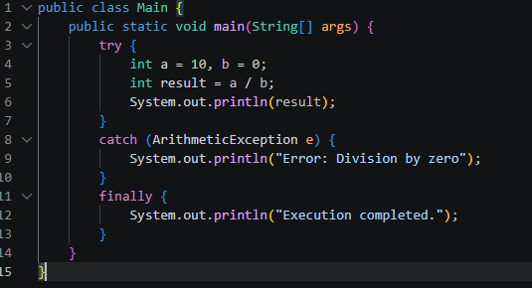
Exception Handling in Java
This Photo by Unknown Author is licensed under CC BY-SA-NC

Slide 17
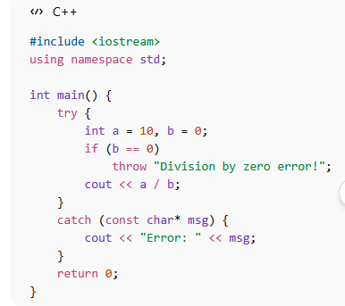
Exception Handling in C++
Uses:
try
catch
throw
This Photo by Unknown Author is licensed under CC BY-SA-NC

Slide 18
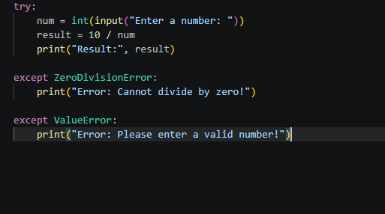
Exception Handling in Python
This Photo by Unknown Author is licensed under CC BY-SA-NC

